Slide 1
How to deploy a lab with Ansible custom modules
Antoine DELEPORTE

Slide 2
Installation
Setup
Examples
ToDo List

Slide 3
Installation
Prepare an Ansible control machine
Docker run –it –v /Users/adeleporte/velocloud:/home/velocloud ubuntu
Install Ansible
apt-get update
apt-get install software-properties-common
apt-add-repository ppa:ansible/ansible
apt-get update
apt-get install ansible
Install Velocloud SDK
cd /home/velocloud/api/sdk/python
python setup.py install
Install PyVomi libraries
apt-get install python-pip
pip install PyVmomi

Slide 4
Setup
Install an ESXi virtual machine
Install NSX-v (use NSX-T in future as NSX-v doesn’t support BGP communities)
Deploy Logical Switches (each network segment is a LS)
Deploy 2 Edges
Internet Edge, with Source Nat to go to Internet
MPLS Edge, with no Access to Internet
Git clone the velocloud ansible repo
git clone https://github.com/adeleporte/ansible_velocloud.git
setup the variables in the playbook : vim /home/velocloud/group_vars/all

Slide 5
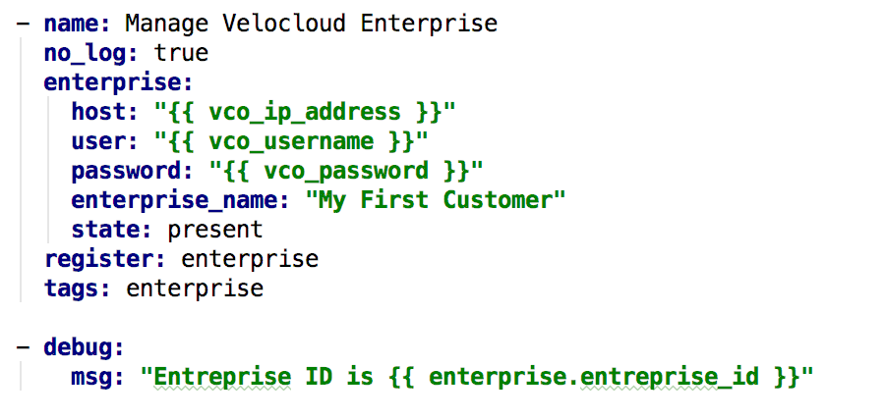
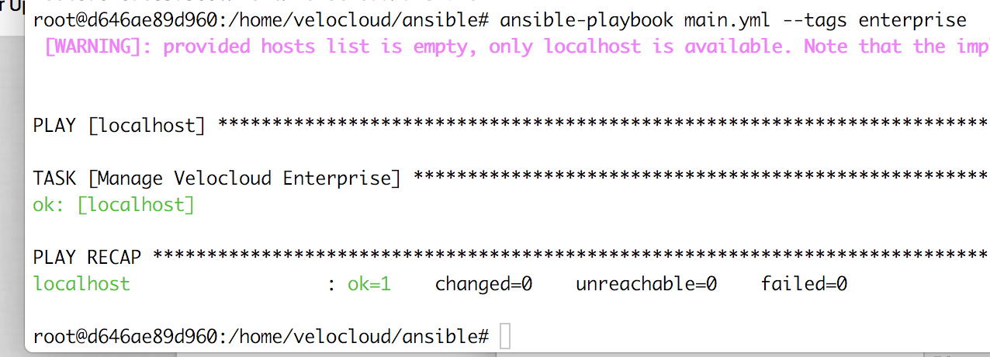
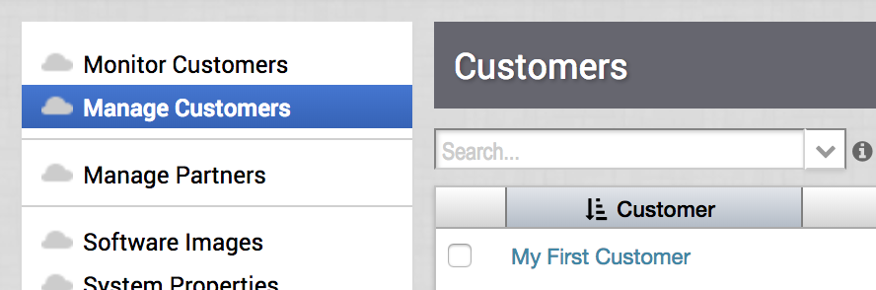
Enterprise Module

Slide 6
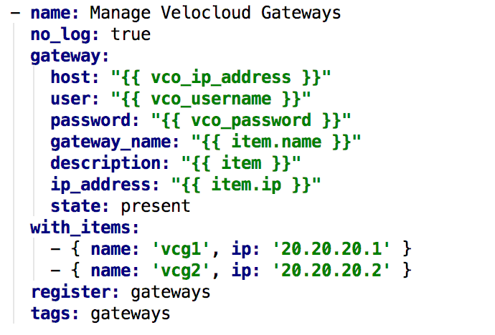
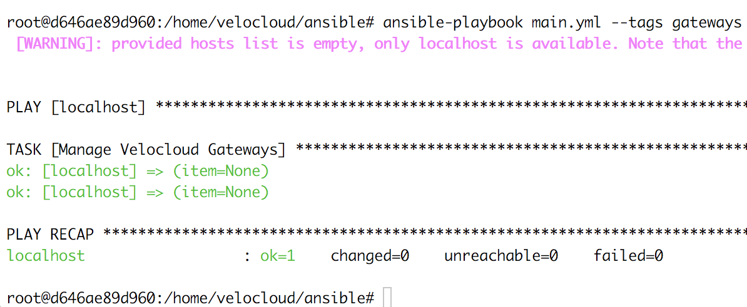
Gateway Module
Create gateways

Slide 7
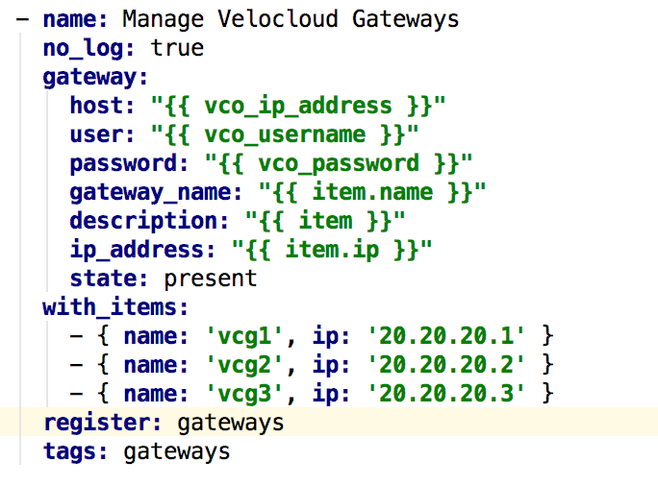
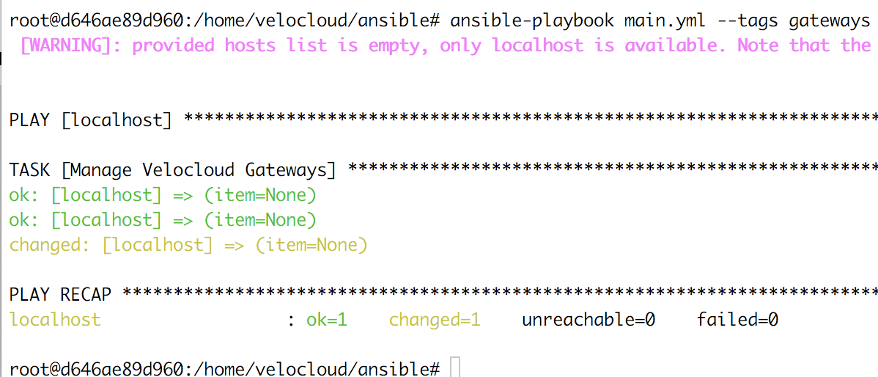
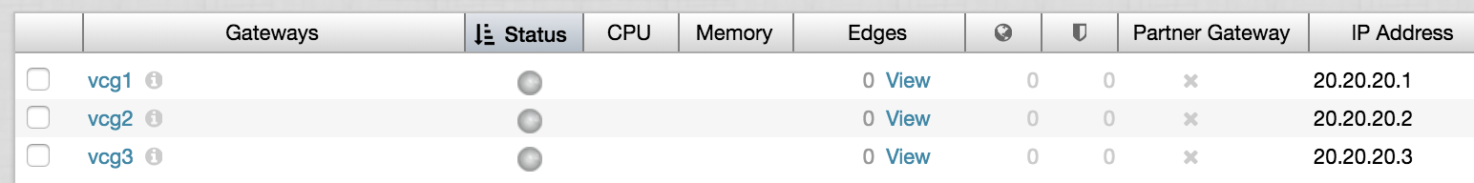
Gateway module
Add a gateway

Slide 8
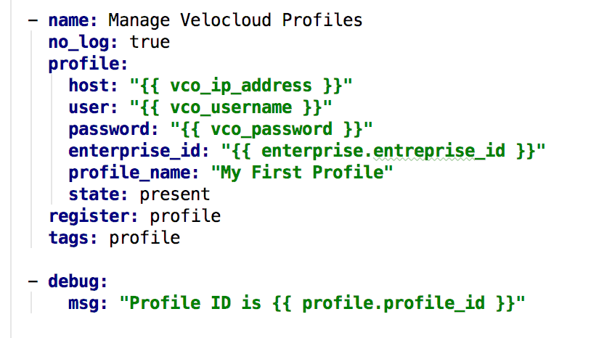
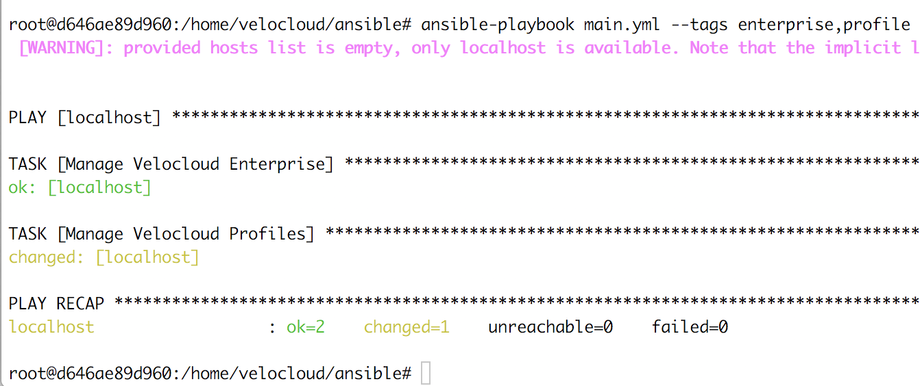
Profile Module

Slide 9
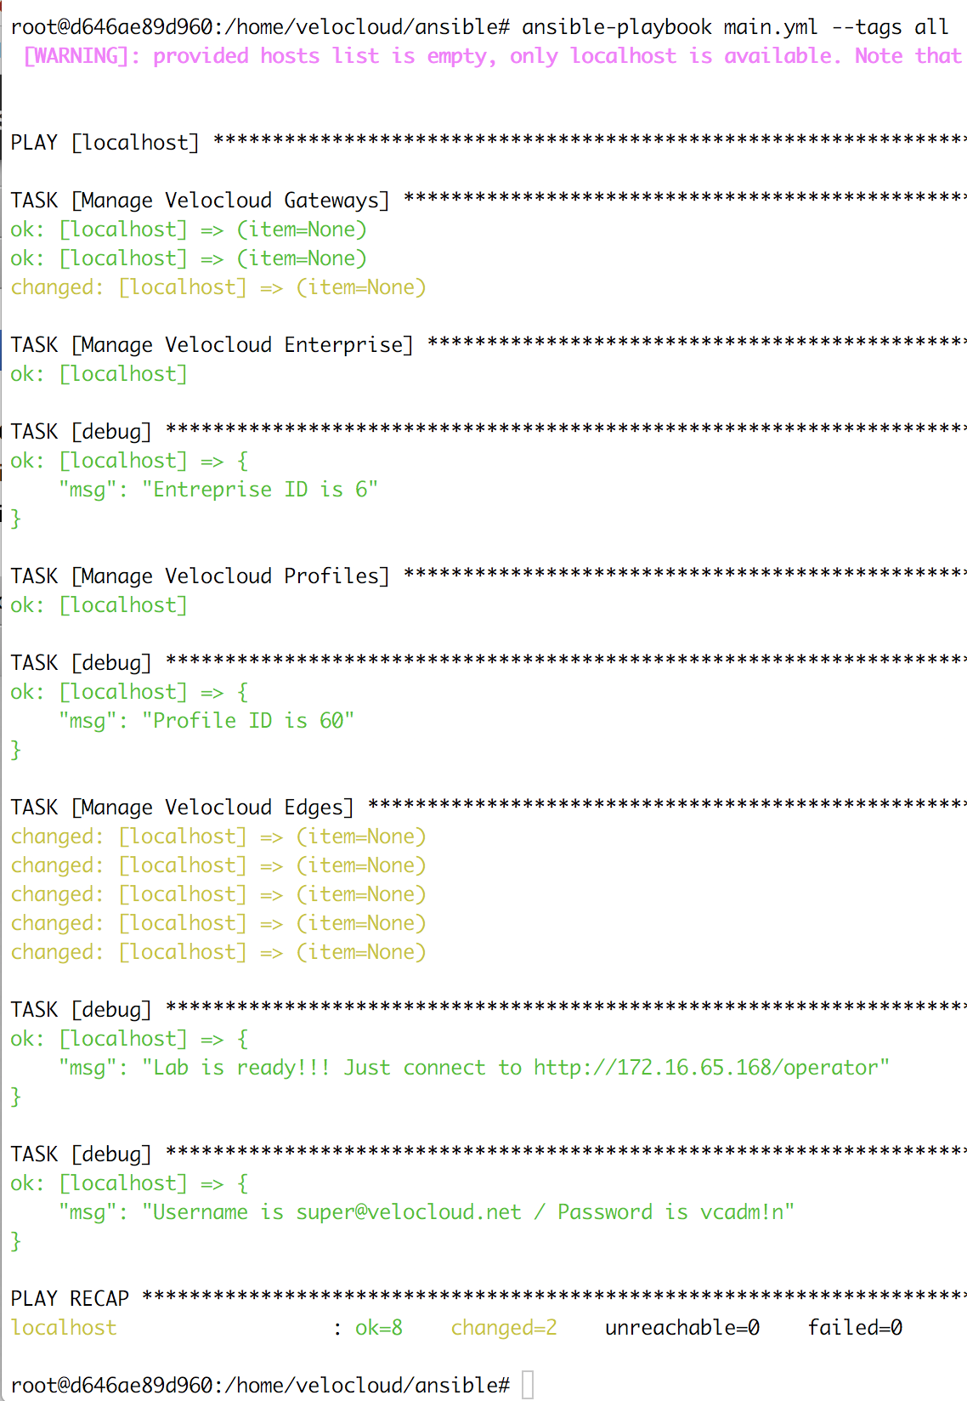
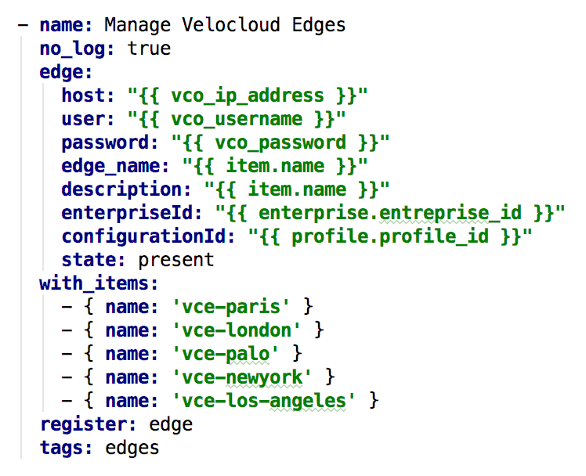
Edge Module

Slide 10
Ova modules
Modules work, I have to document

